Slide 1
Title: An Efficient Machine Learning Approach to Detect Sentiments from Text Data.
CSE-713 Group-Presentation
Group Members:
NAZMUL KARIM TANVIR (23166011)
TOUFIQUL ALAM SAMS (24166027)
TASNIM FUYARA CHHOAN (23366035)
SAMIN YASAR (23273007)

Slide 2
Table of Contents
01
03
05
Motivation & Objectives
Workflow & Methodology
References
02
04
Dataset & Data Analysis
Partial Working Prototype

Slide 3
Introduction
Motivation:
Understanding Human Emotions
Enhancing NLP systems
Improve Decision Making Abilities
Mental Health Analysis
Research Objective:
Comprehend sentiment analysis
Increase level of mid polarities of the datasets
Bias issues

Slide 4
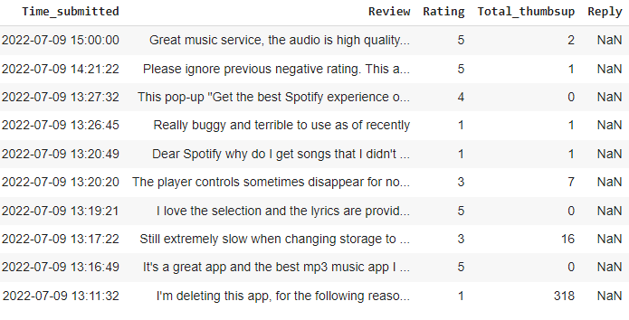
Data analysis
About the Dataset
- Scraping Spotify reviews on Google Play Store
-This dataset contains reviews of Spotify App from 1/1/2022 - 7/9/2022 collected from Google Play Store
-Total Row: 61594 rows
-Total 5 column

Slide 5
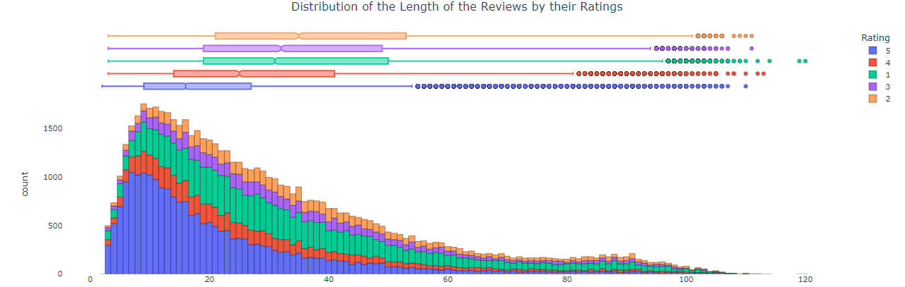
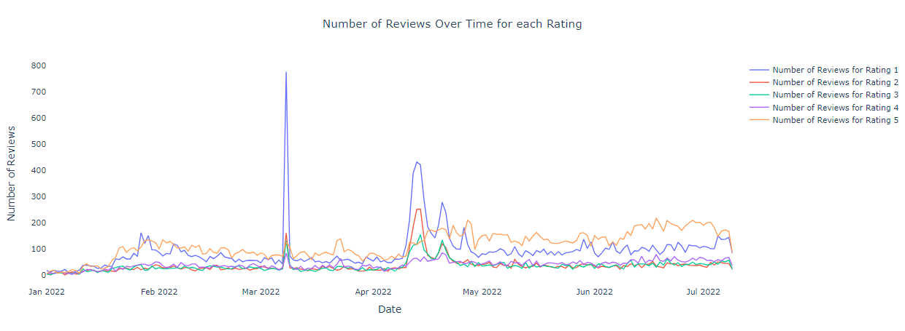
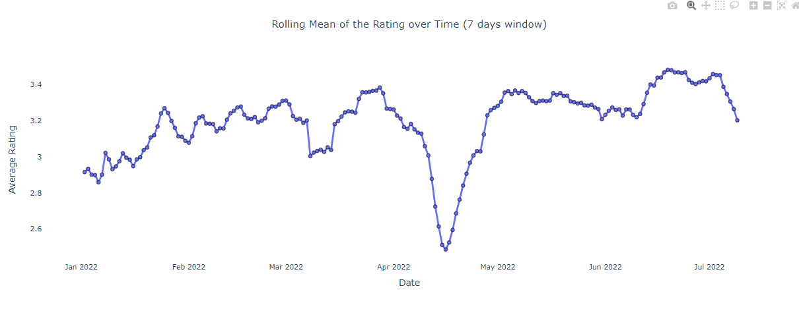
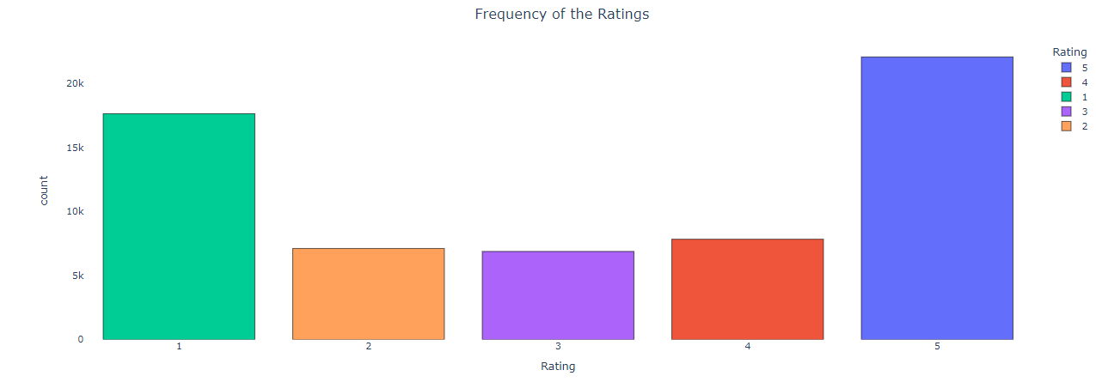
Data analysis

Slide 6
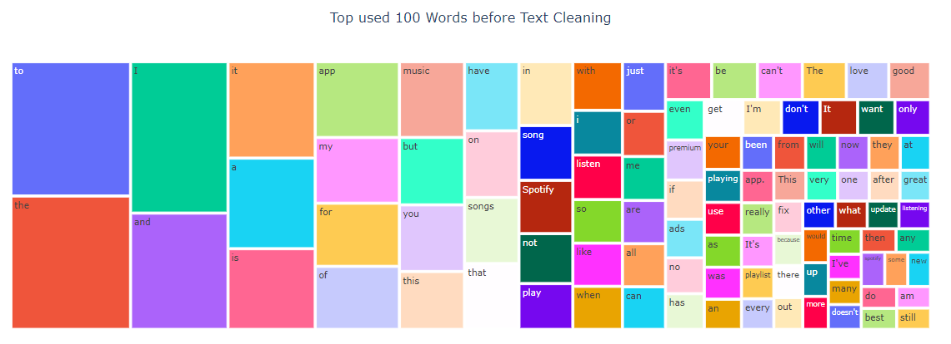
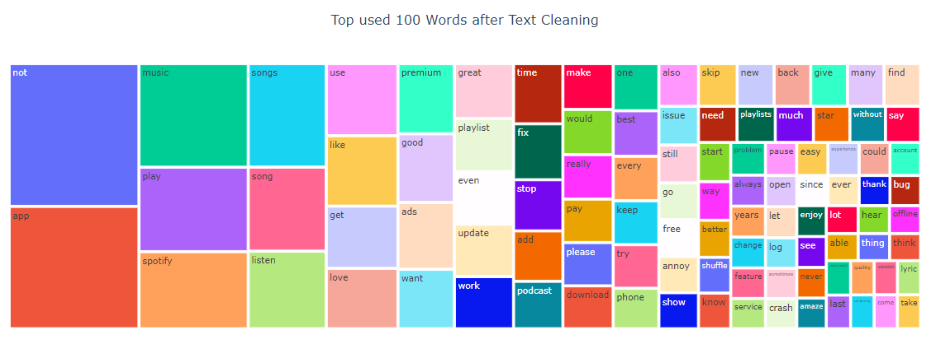
Data analysis (Before vs After Data Wrangling)
Data Wrangling:
-Lowercased all text.
-Expanded contractions.
-Removed numbers, punctuation, emojis, non-Latin characters, and words less than 2 characters.
-Tokenized text and removed stopwords.
-Lemmatized text.
-Additional Pre-Processing

Slide 7


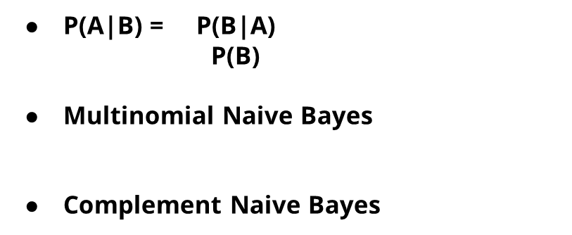
Workflow and Methodology
Naive Bayes Model

Slide 8
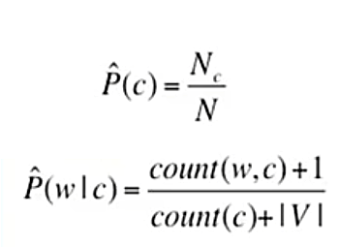

Workflow and Methodology (cont.)
>Multinomial Naive Bayes
>RNN
>Complement Naive Bayes

Slide 9
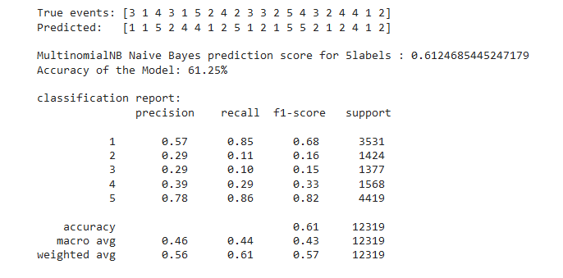
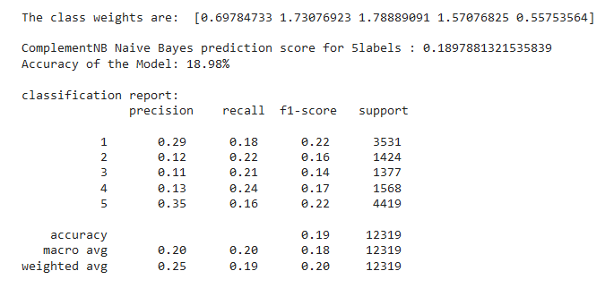
Multinomial NB
Complement NB

Slide 10
References
Mishra, A., Sahay, A., Pandey, M. A., & Routaray, S. S. (2023). News text analysis using text summarization and sentiment analysis based on NLP. In 2023 3rd International Conference on Smart Data Intelligence (ICSMDI) (pp. 28-31). Trichy, India. https://doi.org/10.1109/ICSMDI57622.2023.00014
Tejaswini, Z. , Rajeswari, K. (2022). Sentiment Analysis of Covid-19 Tweets using Twitter Database–A Global Scenario. https://ieeexplore.ieee.org/document/9989000
Dzyuban, Y., Ching, G., Yik, S., Tan, A., Crank, P., Banerjee, S., Pek, R. and Chow, W. (2022). Sentiment Analysis of Weather-Related Tweets from Cities within Hot Climates. Weather, Climate, and Society 14(4) pp. 1133-1145. Available at: https://journals.ametsoc.org/view/journals/wcas/14/4/WCAS-D-21-0159.1.xml . [Accessed 19 Apr 2024].
A. R. Atmadja, A. Rahmawati, C. N. Alam, P. Dauni and Y. Saputra. (2023) . Sentiment Analysis on Tourism Place using Naive Bayes . https://ieeexplore.ieee.org/document/10366891

Slide 11
Thank you Any Question ?

